Slide 1
US Household Income Statistics
Manaswini Vedula(16292800)
Mounika Rachamadugu(16297401)
Pujitha Sakhavarapu(16299783)
Sowmya Reddy Katukuri(16297667)

Slide 2

Introduction
Based on the household income statistics dataset and the predictors provided we calculated the household income as well as taking up the household income and based on the geographic location like latitude and longitude we will observe the data distribution across the united states on a geographical map using the scatter plots.

Slide 3
Dataset
We have taken the dataset from the following link: https://www.kaggle.com/goldenoakresearch/us-household-income-stats-geo-locations
The dataset originally developed for real estate and business investment research. Income is a vital element when determining both quality and socioeconomic features of a given geographic location. The data was derived from over +36,000 files and covers 348,893 location records. The database contains 32,000 records on US Household Income Statistics & Geo Locations. To access, all 348,893 records on a scale roughly equivalent to a neighborhood. The dataset has 32527 rows and 19 columns. Below are the features that the dataset uses to classify the income.

Slide 4
Household & Geographic Statistics
Mean Household Income (double)
Median Household Income (double)
Standard Deviation of Household Income (double)
Number of Households (double)
Square area of land at location (double)
Square area of water at location (double)

Slide 5
Geographic Location
Longitude (double) Latitude (double)
State Name (character)
State abbreviated (character)
State_Code (character)
County Name (character)
City Name (character)
Name of city, town, village or CPD (character)
Primary, Defines if the location is a track and block group.
Zip Code (character)
Area Code (character)

Slide 6
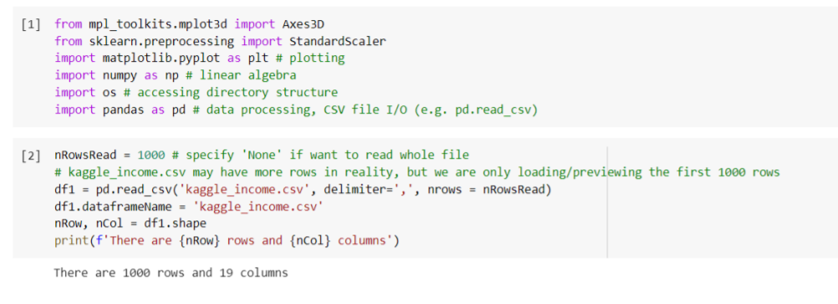
Importing all the required libraries and reading the dataset into a data frame. The data frame contains 1000 rows and 19 columns.

Slide 7
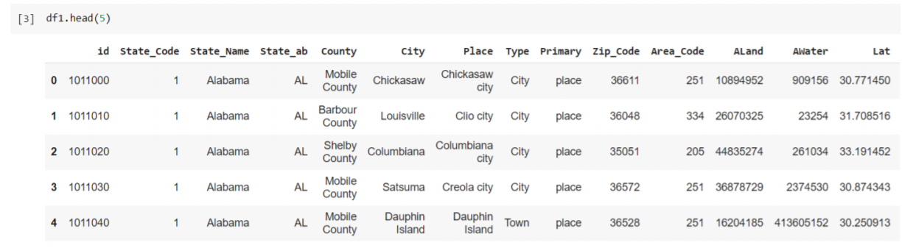
Displaying the top 5 rows of the dataset.

Slide 8
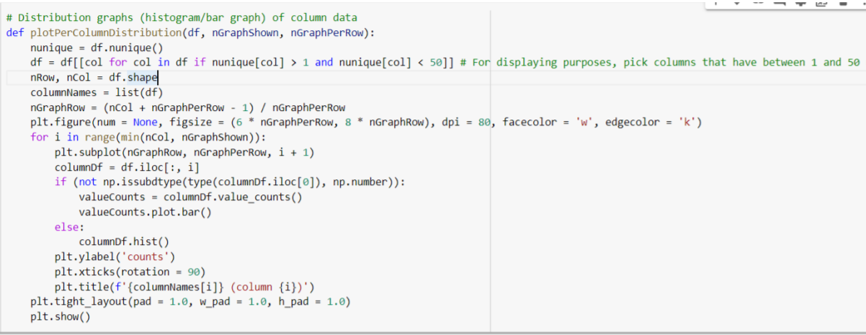
Plotting per column distribution plots if the column value is numerical then we are plotting the bar graph else we are plotting the histogram plots

Slide 9
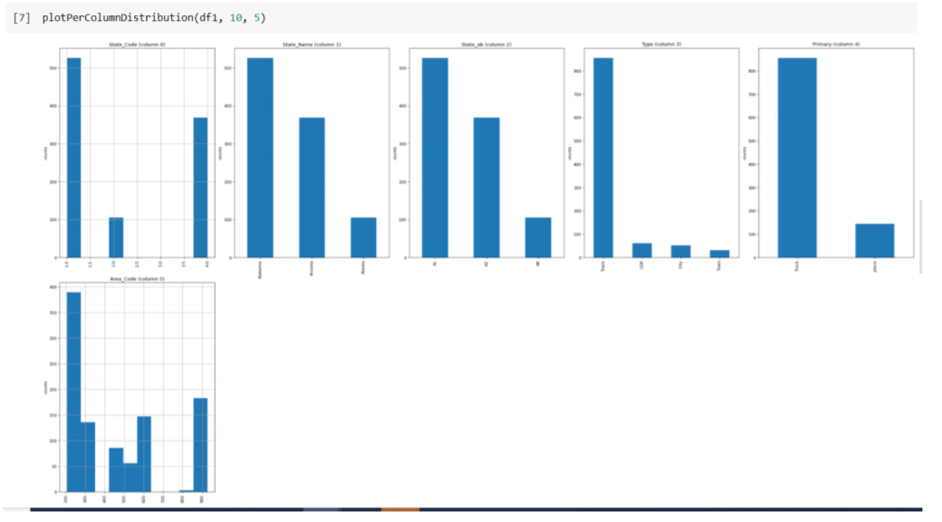
Now calling the function and the output plots are displayed as below.

Slide 10
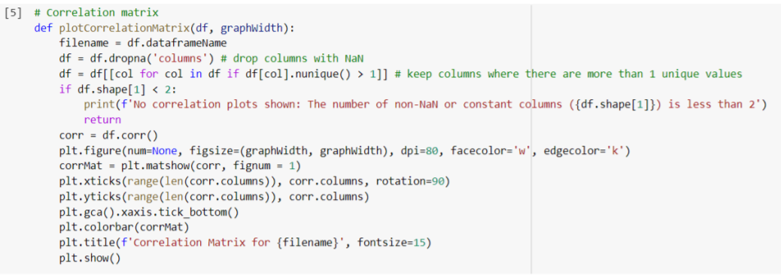
Plotting a correlation matrix dropping the Nan columns

Slide 11
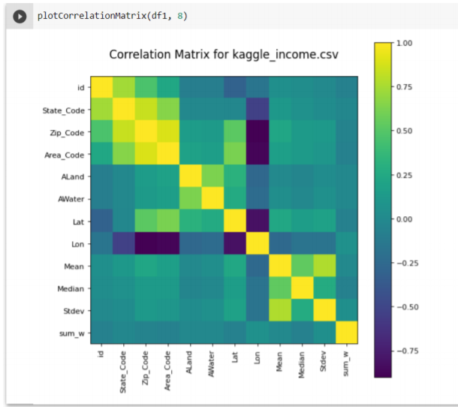
Now calling the function and the correlation matrix is as shown below

Slide 12
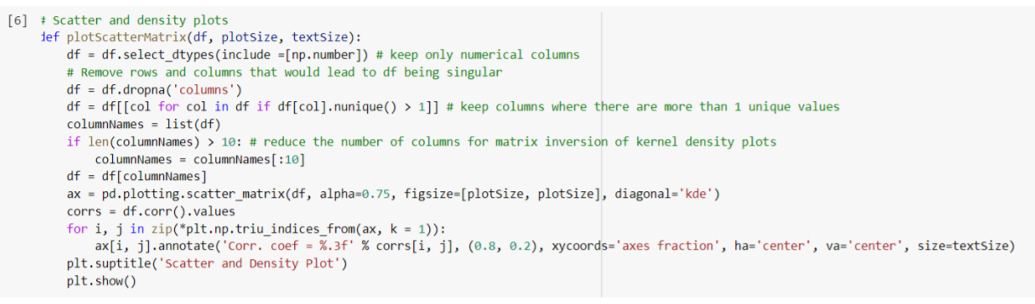
Now plotting the scatter and density plots and the plots are as shown below. These plots show the relation between each column to the other

Slide 13
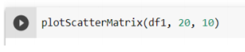
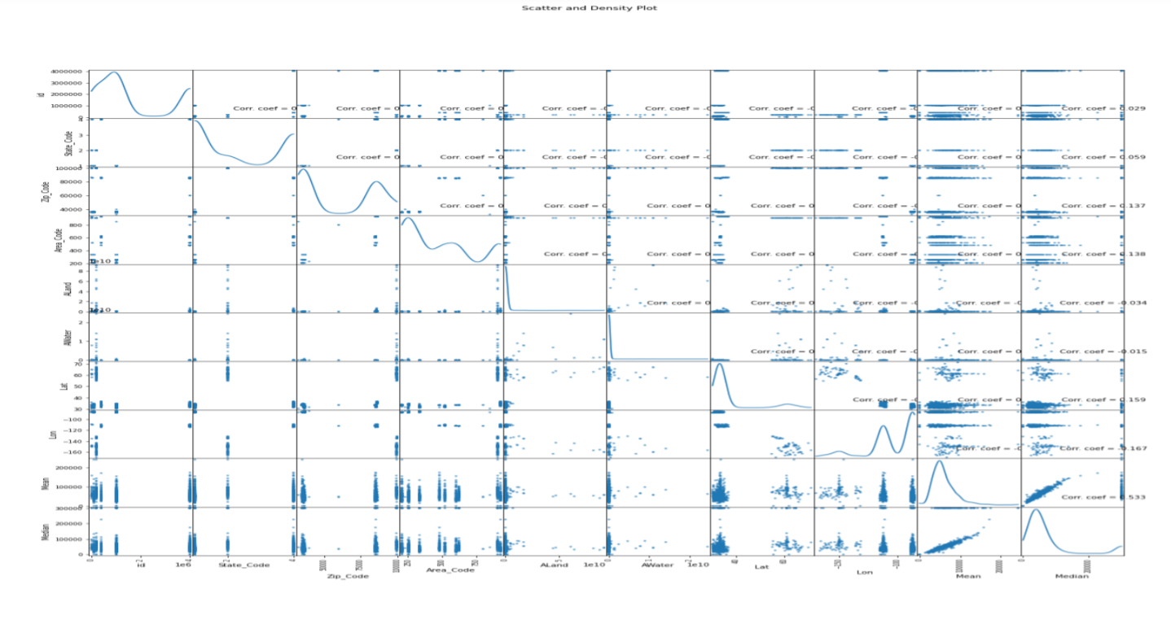
Plotting the scatter matrix plot

Slide 14
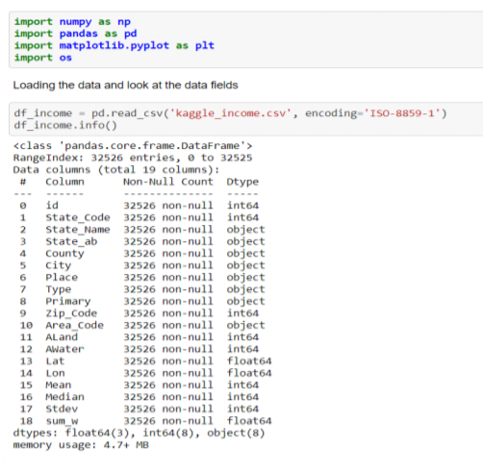
Again, reading the data using a particular encoding and looking at the summary of the data

Slide 15
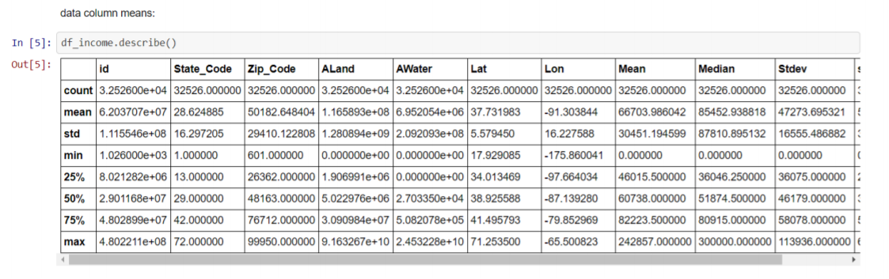
Looking at statistical values of all the columns.

Slide 16
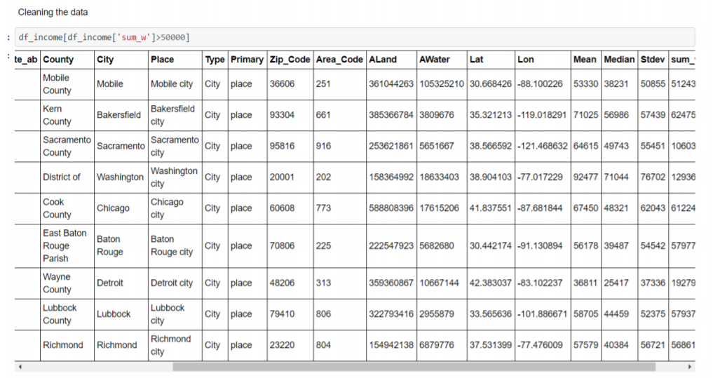
Only taking the data with column sum_w>50000

Slide 17
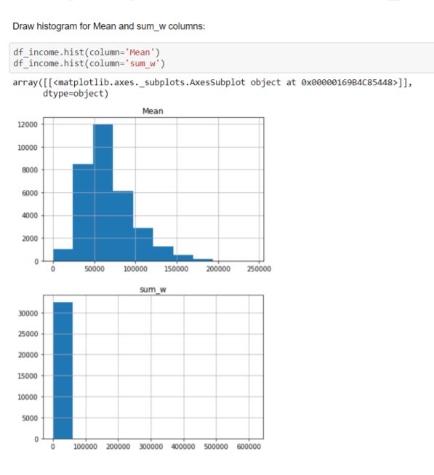
Plotting histograms for the Mean and sum_w to remove the outliers and data of less frequency.

Slide 18
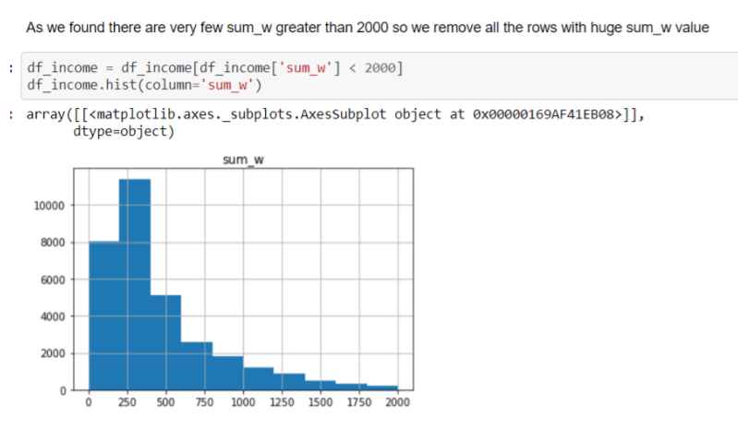
As we have seen that most data is below 2000 so we are taking the rows with sum_w values less than 2000 and plotting them to observe their distribution.

Slide 19
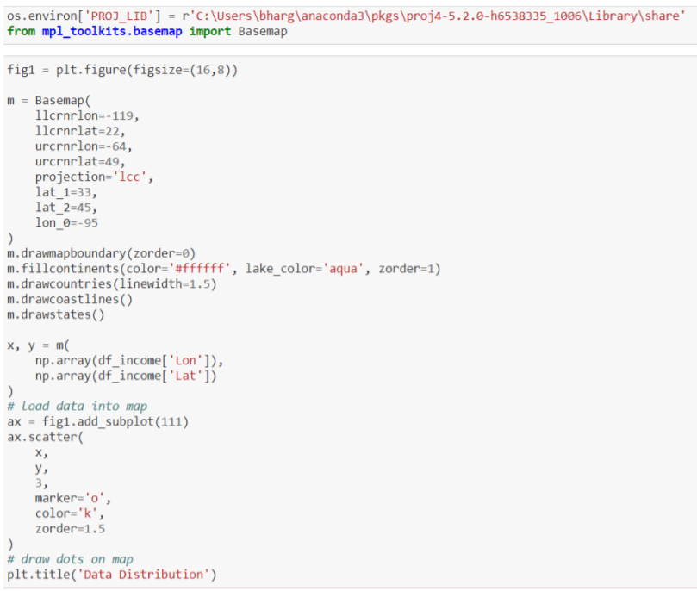
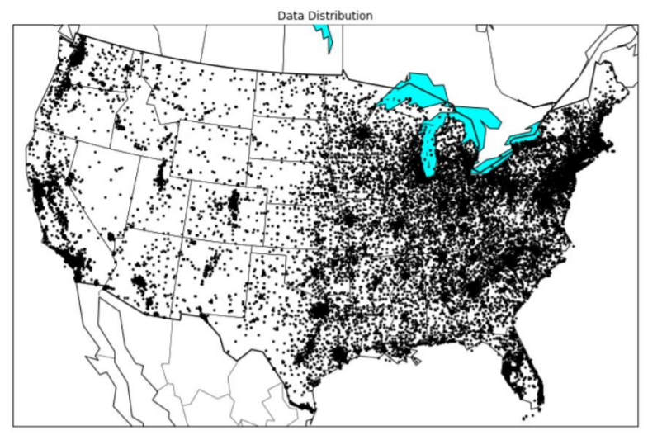
Now Using the Lat Long values in the data set plotting the values to find out the data distribution across the US map.

Slide 20
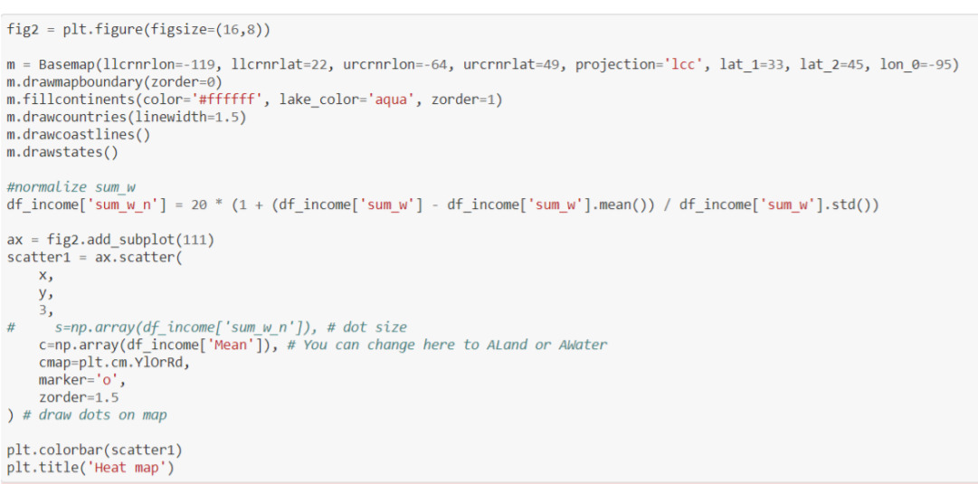
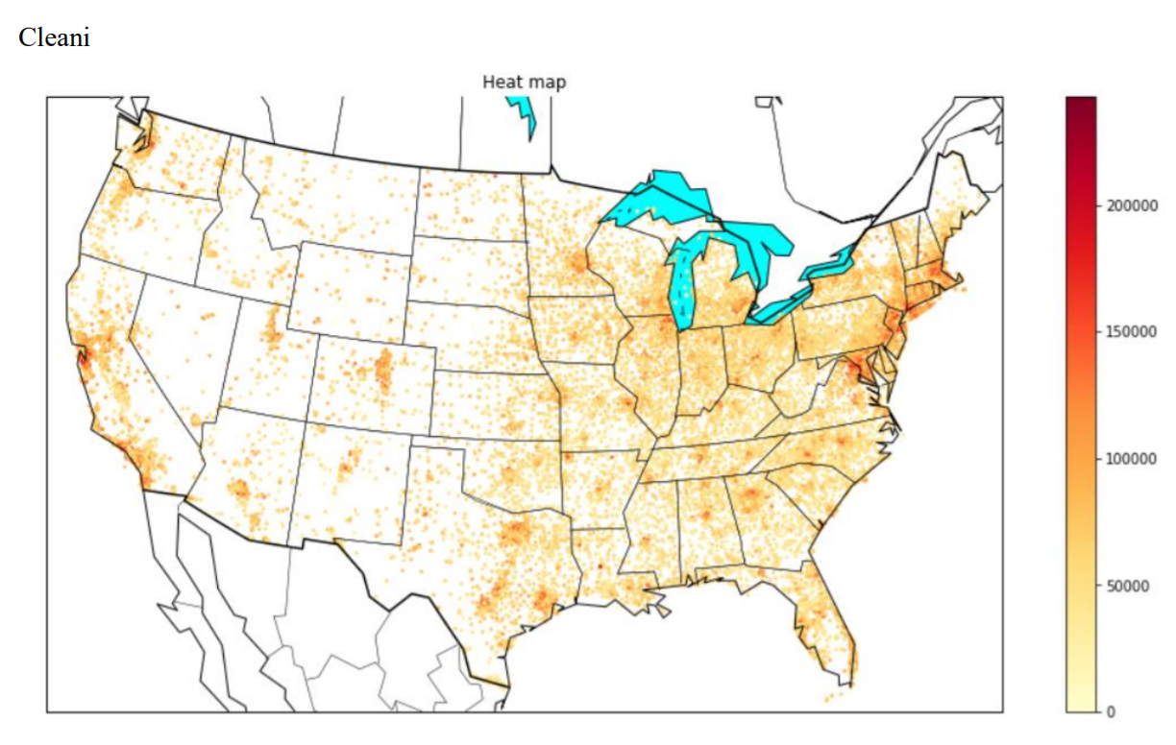
Now Using the sum_w values in the data set plotting the values to know the density of distribution using heat map across the US map.

Slide 21
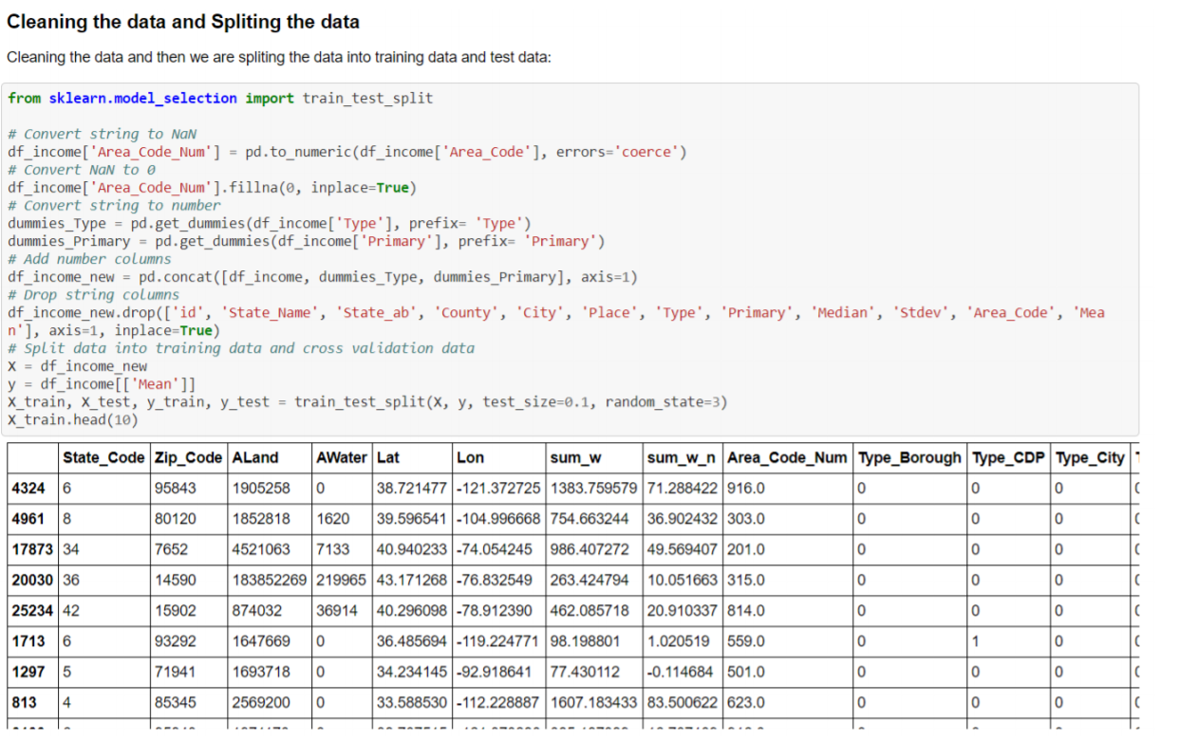
Cleaning and splitting the data set like drop the categorical columns and fill the empty values with zeros.

Slide 22
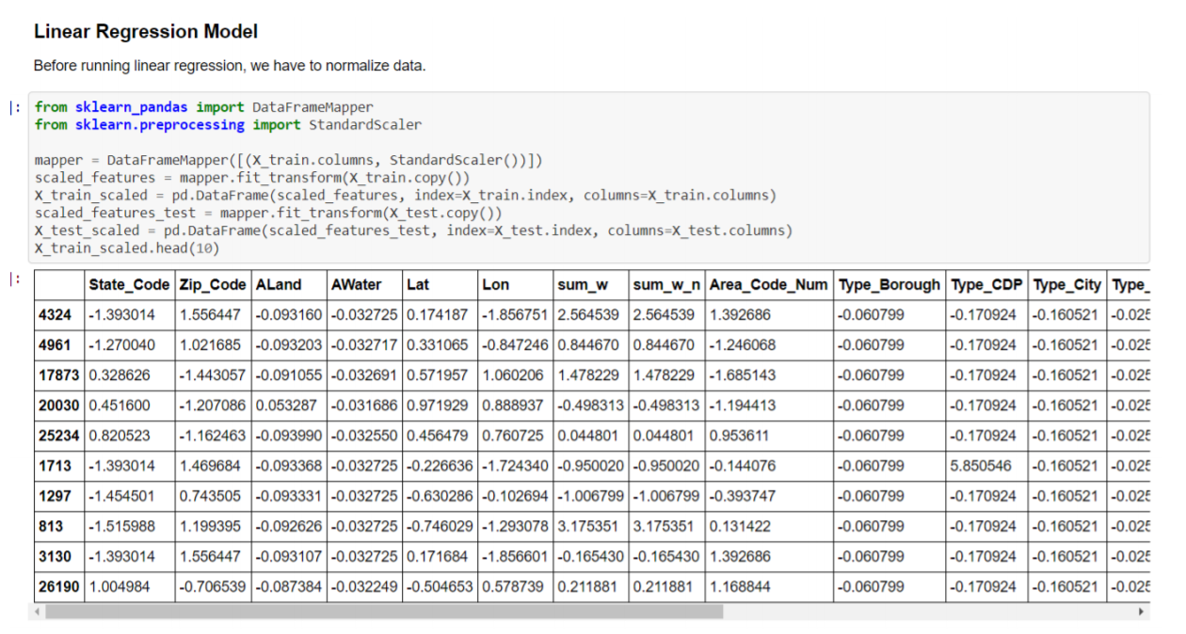
Normalizing values of training and testing before applying them to a model.

Slide 23
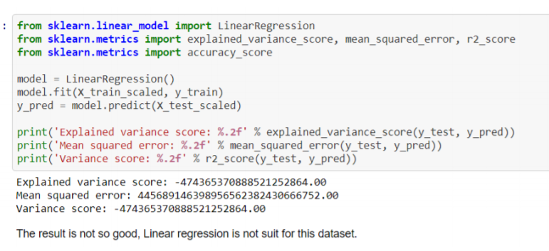
Applying the Linear regression model
Applying the Linear regression model on the dataset and calculated the Variance, MSE and r^2 values.
Linear regression is a Linear approach of modelling the relationship between a dependent variable and one or more explanatory variables.

Slide 24
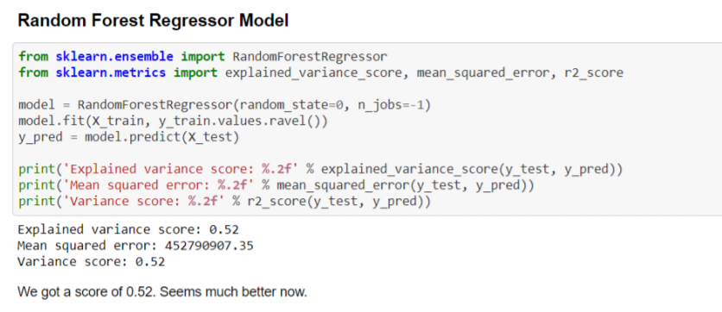
Applying Random forest regressor for the data set
Random forest fits several classifying decision trees on various sub samples of the dataset and uses averaging to improve the predictive accuracy and control overfitting.

Slide 25
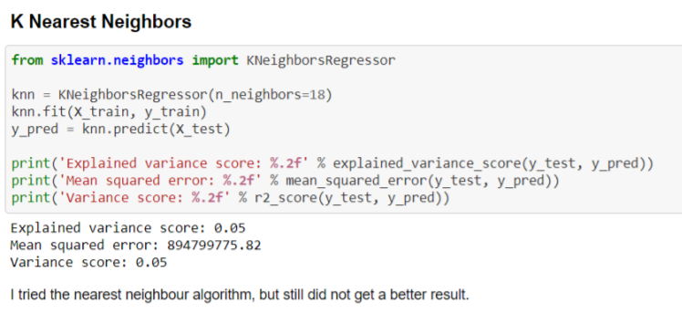
Applying the KNN model on the dataset
It is a supervised machine learning algorithm and is easy to implement that can be used to solve both classification and regression problems.

Slide 26
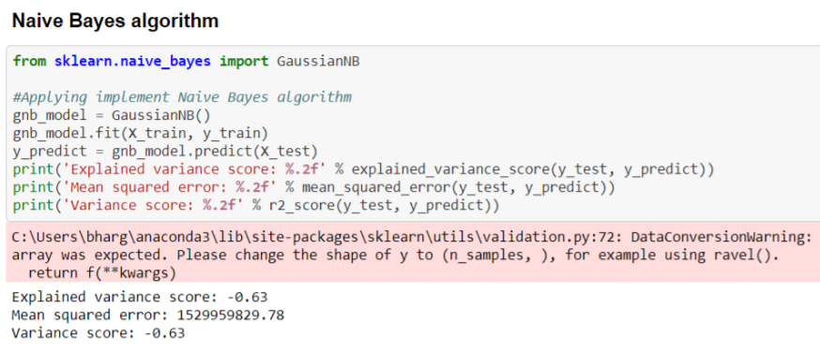
Applying the Naïve Bayes algorithms using Gaussian kernel
It is a classification technique based on Bayes Theorem with an assumption of independence among the predictors. In simple terms, a Naïve Bayes classifier assumes that the presence of a particular feature in a class is unrelated to the presence of any other feature

Slide 27
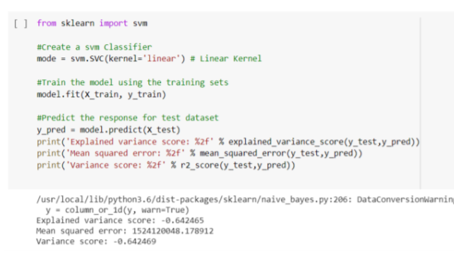
Applying the SVM model on the dataset
SVM is a supervised machine learning algorithm, which can be used for classification or regression problems. SVM find the optimal boundary between the possible inputs.

Slide 28
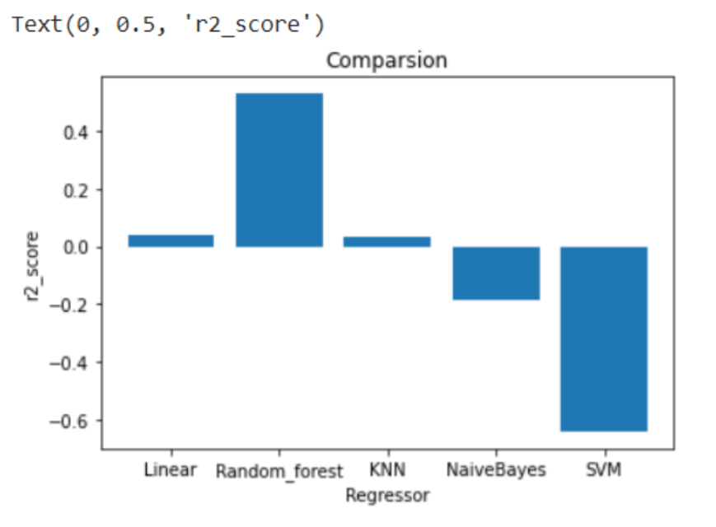
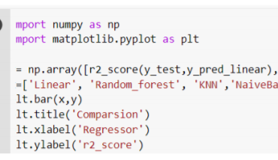
Comparing the Results
Variance, MSE and R^2 values are calculated for each model. Compared the variance r2_score for all the models.

Slide 29
Conclusion
We have applied regression as well as classification techniques for predicting the mean household income from the US income household dataset. From the above observation it is evident that Random forest regressor outperforms all the other applied models in this data set. Where as SVM has high negative impact on the variable’s correlation.

Slide 30

Thank You

